Slide 1


Annual Review
Anima
September 2022
Customer Success Team

Slide 2

Content
Business Understanding
Sources of Data
Exploratory Data Analysis (EDA)
Visualizing Key Trends a Patterns
conclustions

Slide 3

Business Understanding
Our company sells high-quality trousers in India, offering a variety of styles for both casual and formal wear. We focus on providing affordable, durable, and stylish products to our customers. With both online and offline presence.
The goal of this analysis is to evaluate sales performance by identifying key insights such as the top-selling cities, most popular product categories, and the best-performing sales channels. This will help us understand customer preferences and optimize our strategies for greater sales efficiency

Slide 4
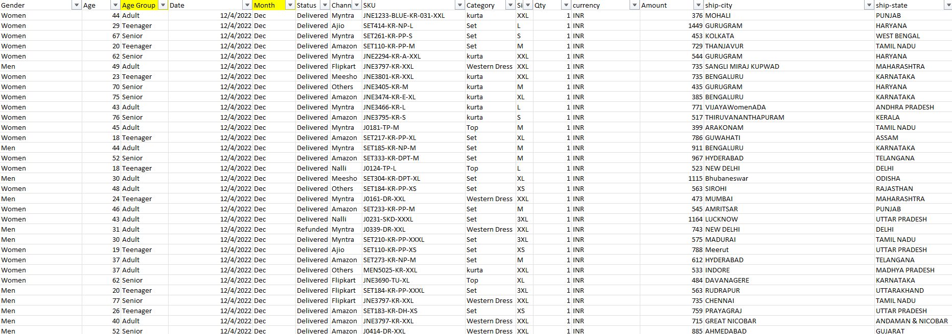
Data Set

Slide 5
Order ID: Unique identifier for the order.
Cust ID: Customer identifier.
Gender: Customer's gender.
Age: Customer's age.
Age Group: Customer's age group (e.g., Adult, Teenager, Senior).
Date: Date of the order.
Month: Month in which the order was placed.
Status: Order status (e.g., Delivered).
Channel: The platform through which the order was made (e.g., Myntra, Ajio).
SKU: Unique product identifier.
Category: Product category or type (e.g., Kurta, Set).
Size: Product size.
Qty: Quantity ordered.
Currency: Currency used (e.g., INR).
Amount: Total amount of the order.
Ship-City: City to which the order was shipped.
Ship-State: State to which the order was shipped.
Ship-Postal Code: Postal code of the shipping location.
Ship-Country: Country to which the order was shipped.
B2B: Whether the transaction is business-to-business (B2B) or not. Here, it’s FALSE, meaning these are individual customer orders.

Slide 6
The order status breakdown:
Delivered: 28,641 orders (most orders delivered).
Cancelled: 844 orders.
Refunded: 517 orders.
Returned: 1,045 orders.
Results from last year
Total amount=21176377

Slide 7
Growth by sector
The quarterly analysis reveals a downward trend in total amounts throughout the year, starting at 5,624,599 in Q1 and gradually decreasing to 4,904,051 in Q4

Slide 8
monthly
Analysis trend
The monthly analysis indicates a downward trend in total sales and order counts throughout the year

Slide 9
Total Sales by Gender:
Women accounted for a significantly higher total sales amount (13,562,773) compared to men (7,613,604).
Order Distribution by Gender and Age Group:
Among adults, women represented 34.59% of orders, more than double that of men (15.47%).

Slide 10
The order distribution across channels shows varying contributions:
Amazon:
Leads with the highest share, contributing 35.48% of total orders.
Myntra:
Comes second with 23.36%, indicating strong customer preference.
Flipkart:
Accounts for 21.59%, making it an important but slightly less dominant channel.

Slide 11

This breakdown highlights Maharashtra as the dominant state, while also showing the significant contributions of other states like Karnataka and Uttar Pradesh in driving overall sales.

Slide 12
Amazon leads with ₹7,519,933 in sales, followed by Myntra with ₹4,941,540. Flipkart comes next with ₹4,573,301, while Ajio has ₹1,331,427. Nalli and Meesho generate ₹1,015,329 and ₹927,606 respectively. Other platforms contribute ₹867,241. In total, these platforms account for ₹21,176,377 in sales, showing the value of selling across multiple channels.

Slide 13
Regarding sizes, M has the highest sales, with 5,485 pieces sold, suggesting that this size is the most popular among customers. On the other hand, Free size had the lowest sales, with only 1,408 pieces sold, indicating that this size may not meet the needs of most customers.

Slide 14
We observe that the Set category is the best-selling, with 12,391 pieces sold, indicating a strong preference for this category among a large segment of customers. In contrast, Tops are the least sold category, with only 2,193 pieces sold, reflecting weaker demand compared to other categories.

Slide 15
This data shows that some orders are being made in larger quantities than others, with the highest reaching 12 items per order.

Slide 16

Recommendation
trending
negative
Based on the previous data analysis, the following recommendations can be made:
Improve Product Category Distribution:
Since Set is the top-selling category, it is advisable to focus on expanding and diversifying this category to further increase sales.
As Top is the least sold category, marketing campaigns can be implemented to increase awareness of this category, or consider redesigning it to better align with customer preferences.
Review Marketing Strategies for Less Popular Sizes:
The low demand for Free size could be addressed by understanding why customers prefer other sizes. Improvements could be made to the designs or styles in this size, or targeted marketing campaigns could be created to encourage interest.
For M size, which has the highest sales, it's important to ensure it is always available and consider expanding its range.
3-Target High-Performing Regions for Marketing:
1.With Maharashtra being the highest-performing region, marketing efforts should be concentrated here. Additionally, trends in Karnataka and Uttar Pradesh should be studied to capitalize on regional performance.
2.For regions with lower sales, further research should be conducted to understand customer preferences and potentially improve targeting through local advertising campaigns.

Slide 17
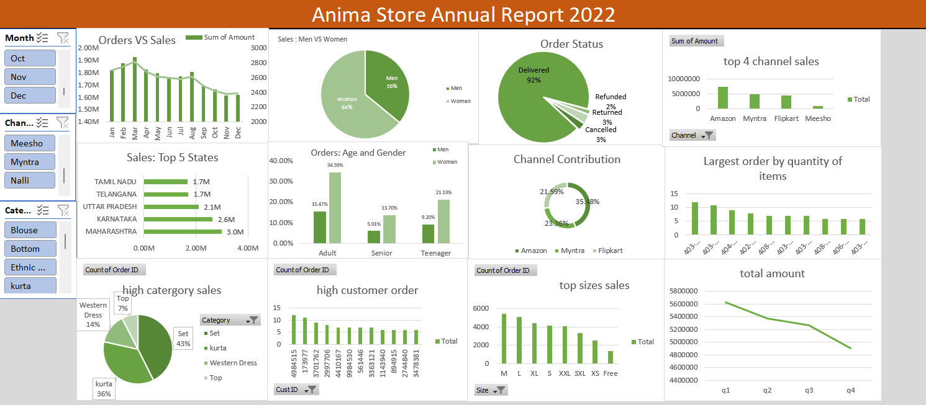

Slide 18
?
Thanks
Do you have any question

